Slide 1

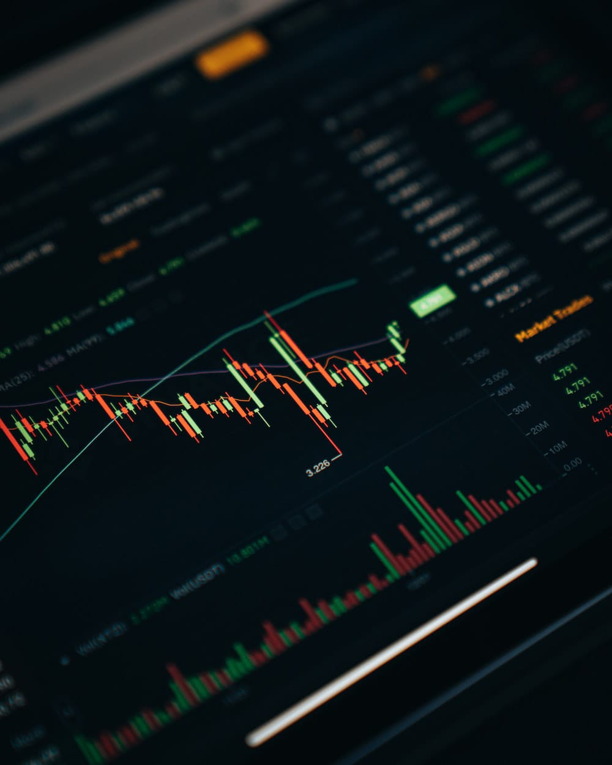
TRADING BOT USING PYTHON
BY AKHILA C U

Slide 2
CONTENTS
ABSTACT
01
PURPOSE AND OVERVIEW OF TRADING
02
MODULES
03
DATASET DESCRIPTION
04
OUTPUT
05
CONCLUSION
06

Slide 3
ABSTRACT
In the fast-paced world of foreign exchange (forex) trading, efficient and data-driven decision making is paramount for success. This project explores the development of an automated forex trading system using Python, integrated with the OANDA API. OANDA provides a robust platform for accessing real-time forex market data and executing trades, making it an ideal choice for this endeavor.
The system collects, stores, and analyzes historical and real-time forex market data. This analysis is fundamental to strategy development. Python's libraries are used to create and fine-tune trading strategies. Users can implement technical indicators, machine learning models, or any custom logic to inform trading decisions. Robust risk management tools are integrated to protect against excessive losses. This includes setting stop-loss and take-profit levels. A user-friendly interface allows traders to monitor the system's performance, tweak parameters, and access trading reports

Slide 4
PURPOSE AND OVERVIEW OF TRADING
PURPOSE OF TRADING
Trading refers to the buying and selling of financial instruments, such as stocks , bonds, commodities, currencies, and other assets, with the aim of making a profit. The primary purpose of trading is to capitalize on price movements and fluctuations in the market. Traders engage in various financial markets to take advantage of opportunities and manage risks.
If you want to trade in the share market, you should have a good grasp of the fundamentals of share trading. Investing is very much essential these days as savings alone is not adequate to beat inflation and fulfill all our financial goals. It involves vigorous participation in the financial markets in comparison to investing, which primarily works on a buy-and-hold strategy.

Slide 5
FOREX TRADING
WHAT IS FOREX TRADING ?
Forex trading, also known as foreign exchange trading or currency trading, involves the buying and selling of currencies on the foreign exchange market with the goal of making a profit. The forex market is the largest and most liquid financial market in the world, where currencies are traded 24 hours a day, five days a week.

Slide 6
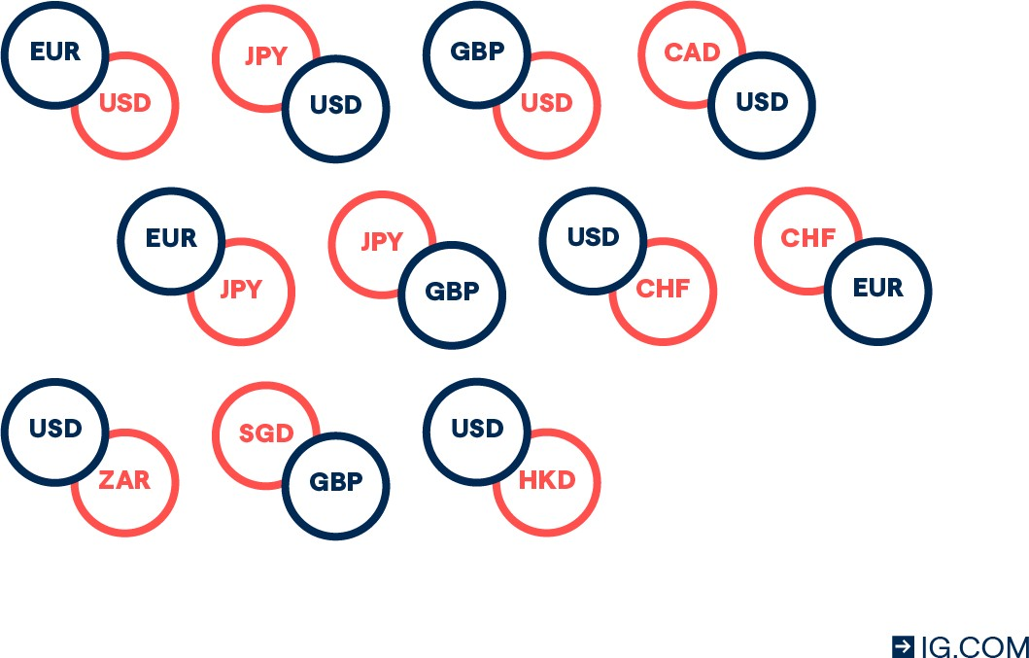
WHAT IS A FOREX PAIR ?
A forex pair is a combination of two currencies that are traded against each other. There are hundreds of different combinations to choose from, but some of the most popular include the euro against the US dollar (EUR/USD), the US dollar against the Japanese yen (USD/JPY) and the British pound against the US dollar (GBP/USD).

Slide 7
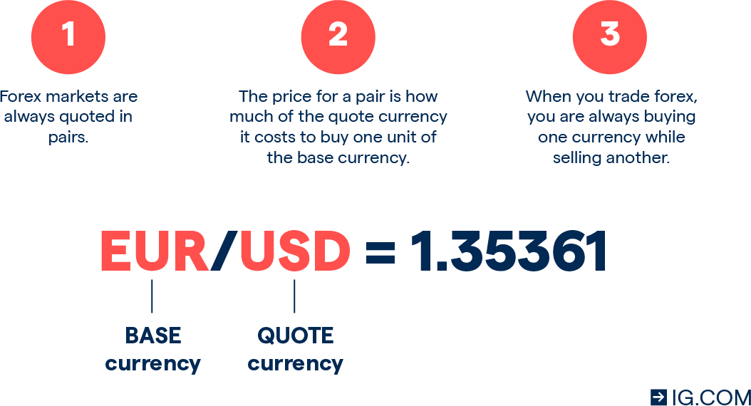
What are the base and quote currencies?
The base currency is always on the left of a currency pair, and the quote is always on the right. The base currency is always equal to one, and the quote currency is equal to the current quote price of the pair – which shows how many of the quote currency it’ll cost to buy one of the base. So, when you’re trading currency, you’re always selling one to buy another.

Slide 8
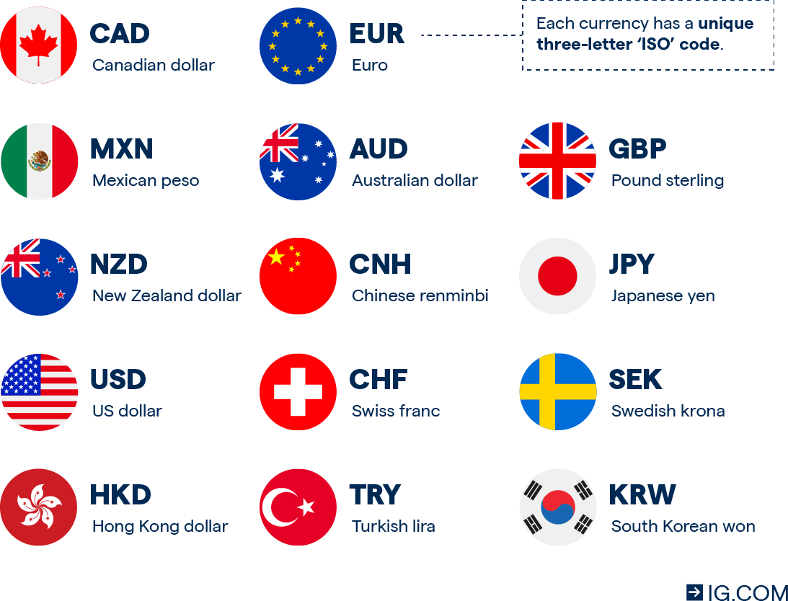
How does forex trading work?
Forex trading works like any other transaction where you are buying one asset using a currency. In the case of forex, the market price tells a trader how much of one currency is required to purchase another. For example, the current market price of the GBP/USD currency pair shows how many US dollars it would take to buy one pound. Each currency has its own code – which lets traders quickly identify it as part of a pair. We’ve included codes for some of the most popular currencies below

Slide 9
What does it mean to buy or sell a currency pair?
To buy a currency pair means that you expect the price to rise, indicating that the base currency is strengthening relative to the quote currency. To sell a currency pair means that you expect the price to fall, which would happen if the base currency weakened against the quote. For example, you’d ‘buy’ the GBP/USD pair if you think that the pound will strengthen against the dollar – meaning you’ll need more dollars to buy a single pound. Or, you’d ‘sell’ this pair if you think that the pound will weaken against the dollar – meaning you’ll need fewer dollars to buy a single pound.

Slide 10
Why do people trade forex?
Taking a position on currencies strengthening or weakening Traders make a prediction on forex pairs to profit from one currency strengthening or weakening against another. When the price of a pair is rising, it means that the base is strengthening against the quote and when it’s falling, the base is weakening against the quote.
That’s because a rising price means that more of the quote are needed to buy a single unit of the base, and a falling price means that fewer of the quote are needed to buy one of the base. So, traders would likely go long if the base is strengthening relative to the quote currency, or short if the base is weakening. Some of the most popular forex trading styles are scalping, day trading, swing trading and position trading. You might choose a different style depending on whether you have a short- or long-term outlook.

Slide 11
HISTORY OF TRADING
BATTER SYSTEM
INTRO OF MONEY
SILK ROAD
MEDIEVAL TRADE
AGE OF EXPLORATION
COLONIAL TRADE
INDUSTRIAL REVOLUTION
STOCK EXCHANGE
GLOBAL TRADE AND FREE TRADE
ELECTRONIC TRADING
HIGH FREQUENCY TRADING
CRYPTOCURRENCY TRADING

Slide 12
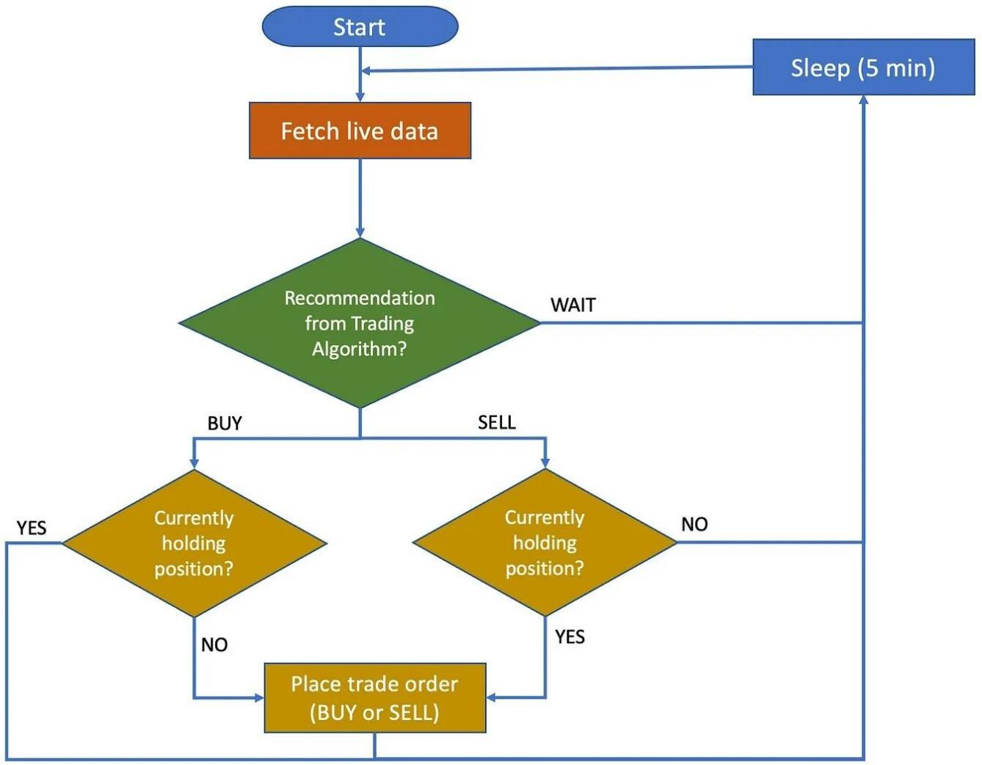
FLOW CHART

Slide 13
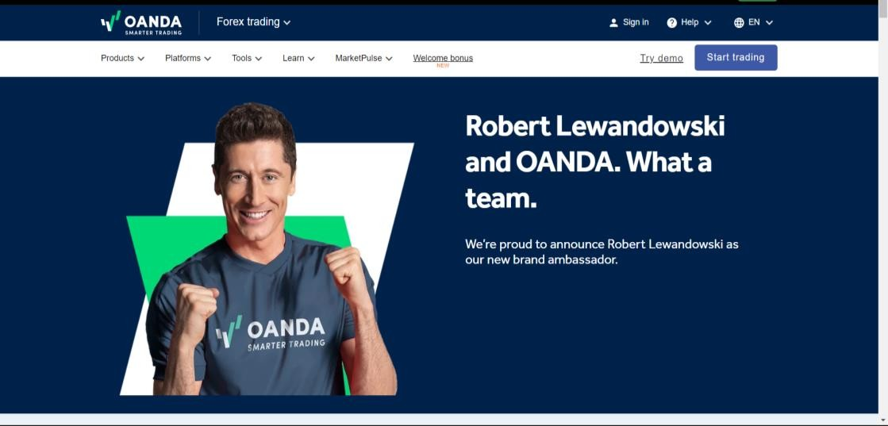
MODULES
STEP 1
The User Registers by connecting their Trading account with the BOT. Then Login via username and Password.

Slide 14
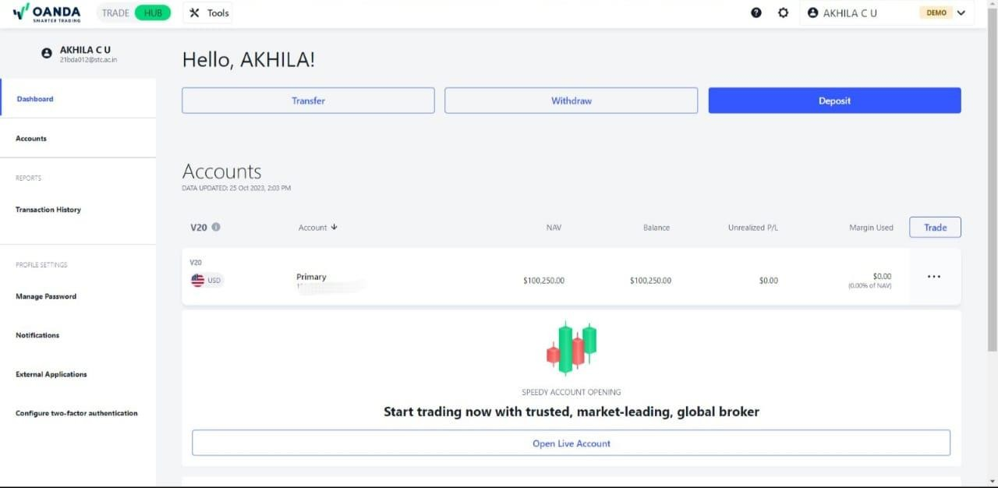
STEP 2
Portfolio page which displays Live Market Statistics, Bot Trade History, Account Details, Wallet, and Revenue opens.

Slide 15
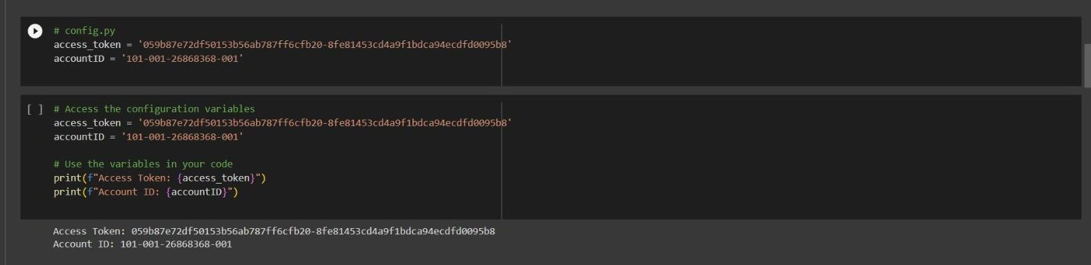
STEP 3
On the Portfolio page, we can add deposit withdraw the money . Create your own API tokens Enter Trading strategy, Stock names the user wants to trade in, Entry and Exit Points, Stop Loss value, and Strategy specific parameters (Eg: Moving Averages). Then Run the BOT. Before running the bot check weather the API expires or not.

Slide 16
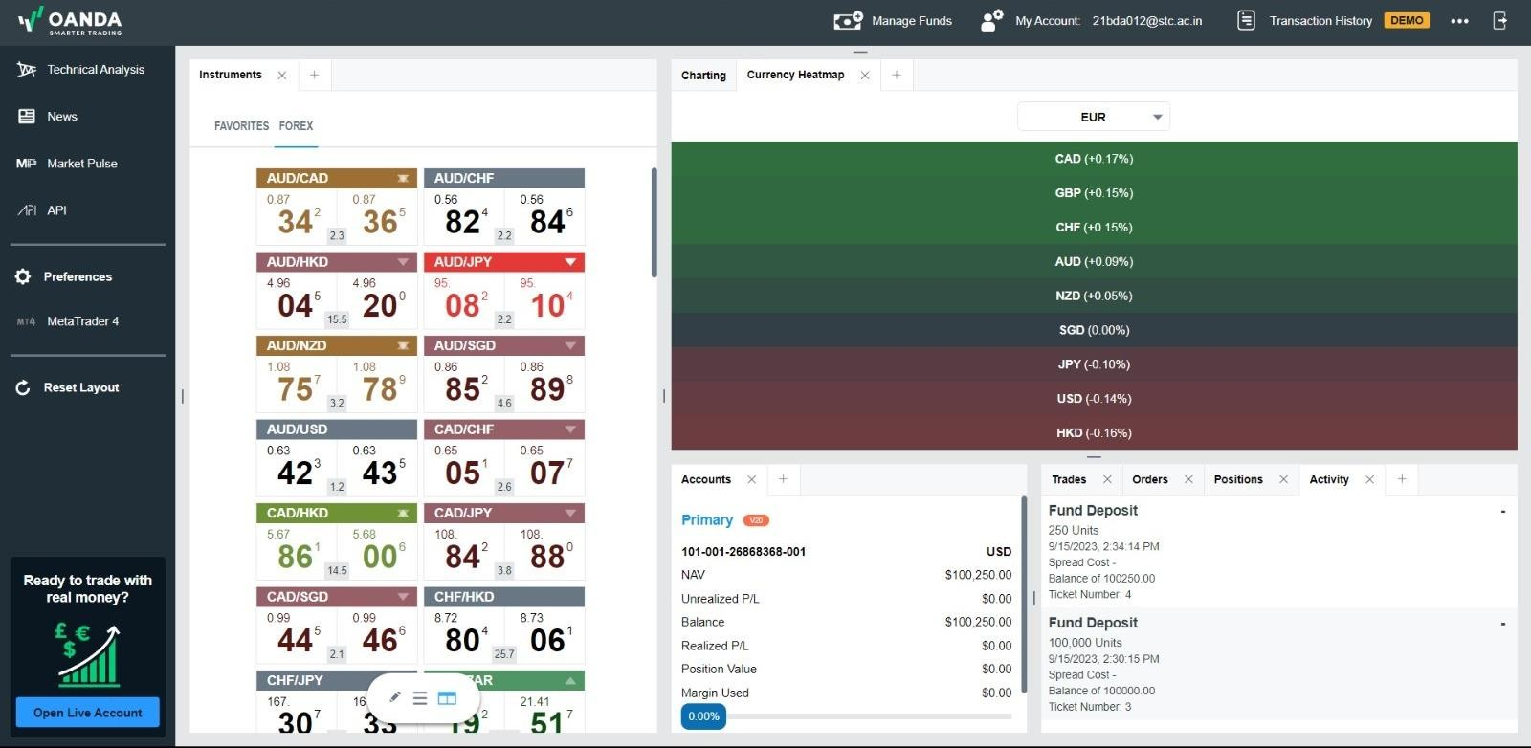
STEP 4
The BOT will constantly fetch and check the Live Market Scenario, current Open Positions, and User Wallet and Profit/Loss parameters to validate if a position can be taken for a stock in the market and decide what kind of trade is to be done. The BOT automatically calculates a number of shares to trade in keeping in mind the Targeted Profit, Stop Loss, Entry/Exit Points as well as preserving Wallet.

Slide 17
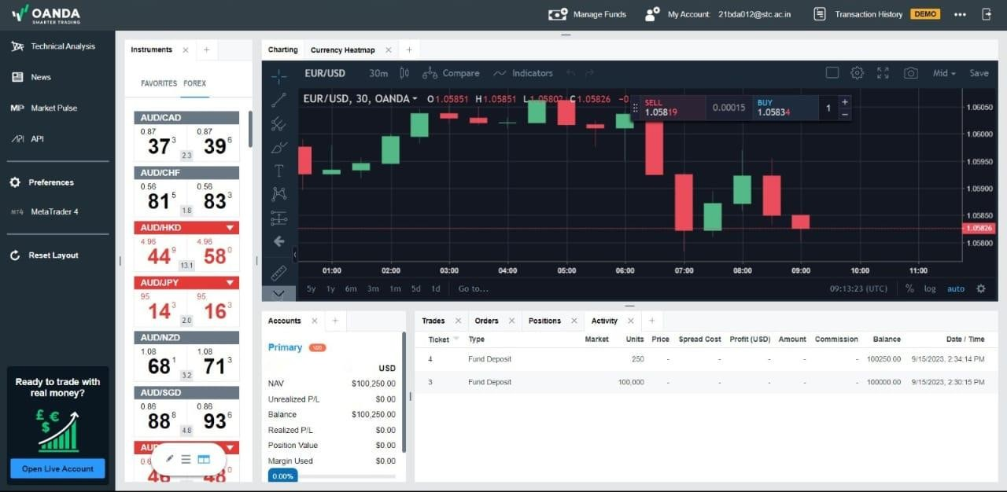
STEP 5
The BOT will perform Automated Trading as per the Strategy and parameters set by the user and validating with the market to get Enhanced Performance and Revenue as compared to Manual Trading. The BOT will continue to do so until The Market Closes or Exit Points/Stop Loss is reached or The user sends a signal to stop.

Slide 18

DATASET DESCRIPTION
Dataset : yfinance --yf.download("EURUSD=X", start="2022-10-7", end="2023-11-16", interval='1h’)
6861 Records,6 Attribute
Attribute information: Open, High, Low, Close, Adj Close, Volume

Slide 19
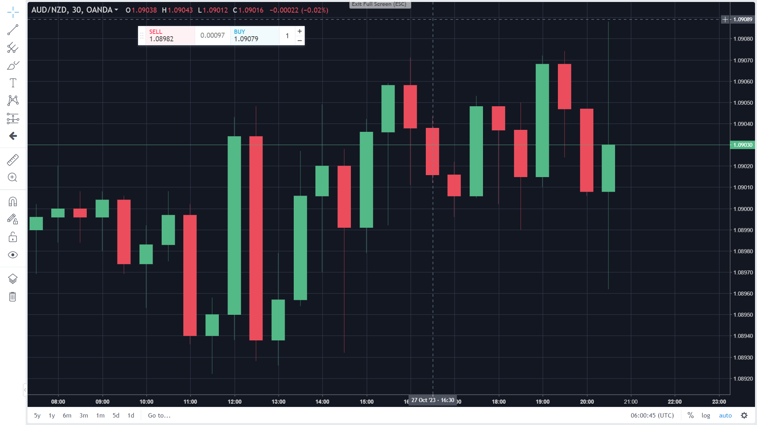
OUTPUTS

Slide 20
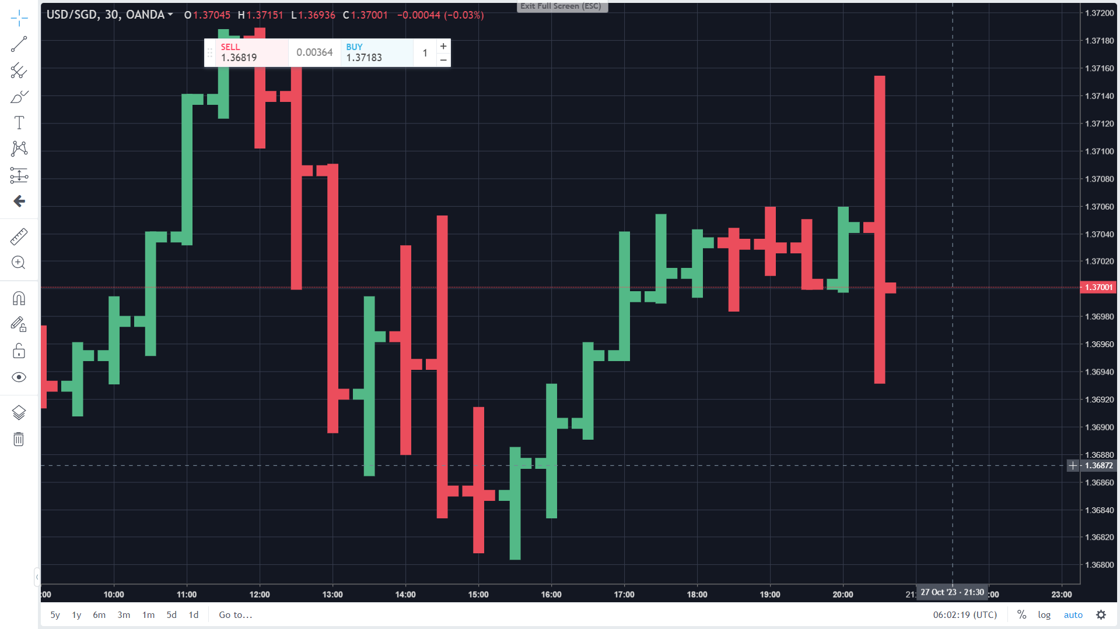
BAR CANDLES

Slide 21
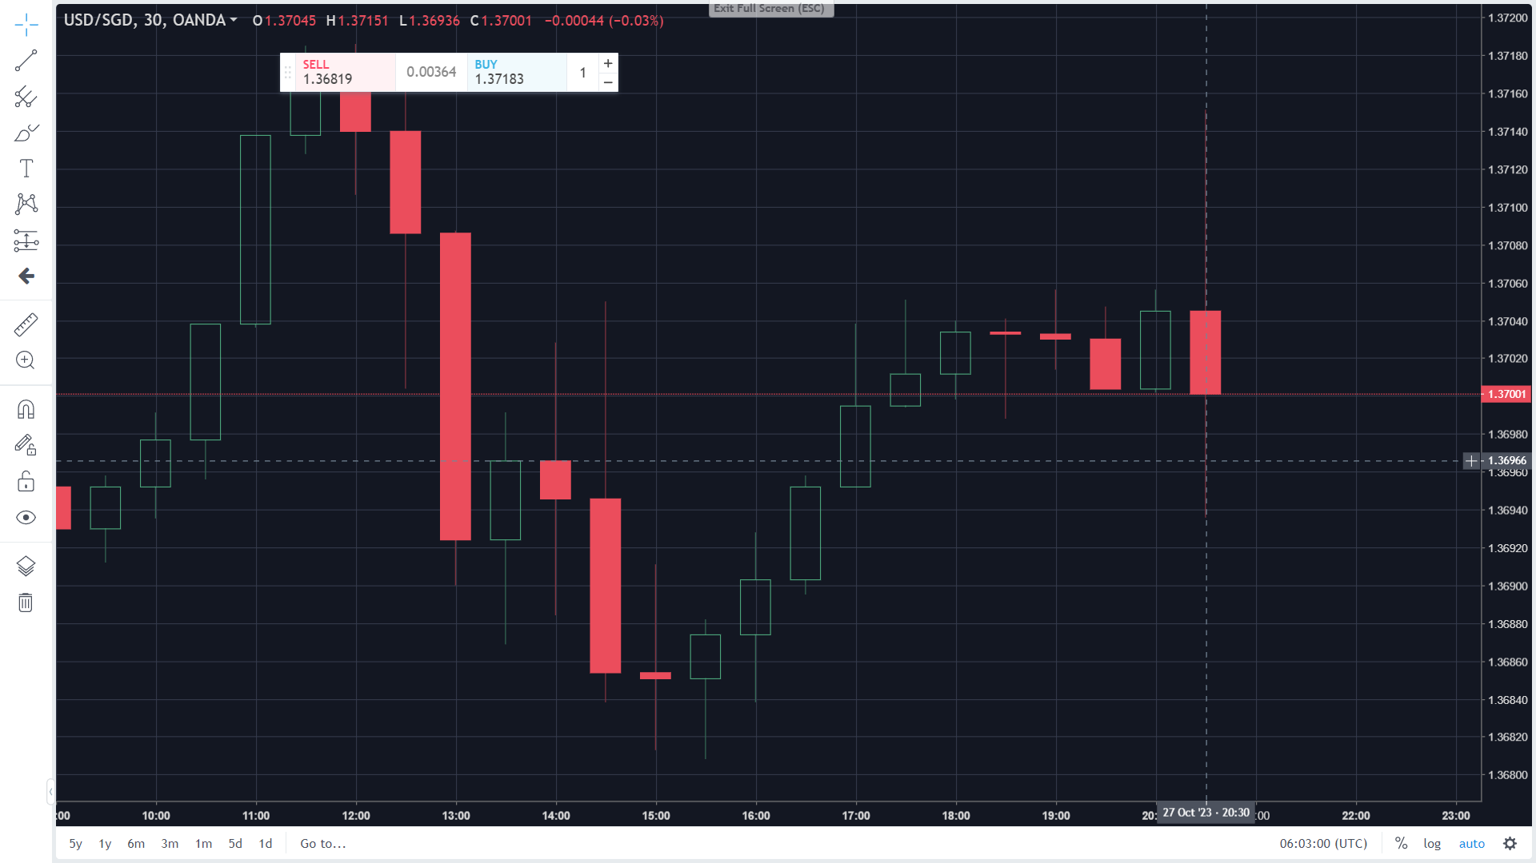
HOLLOW CANDLES

Slide 22
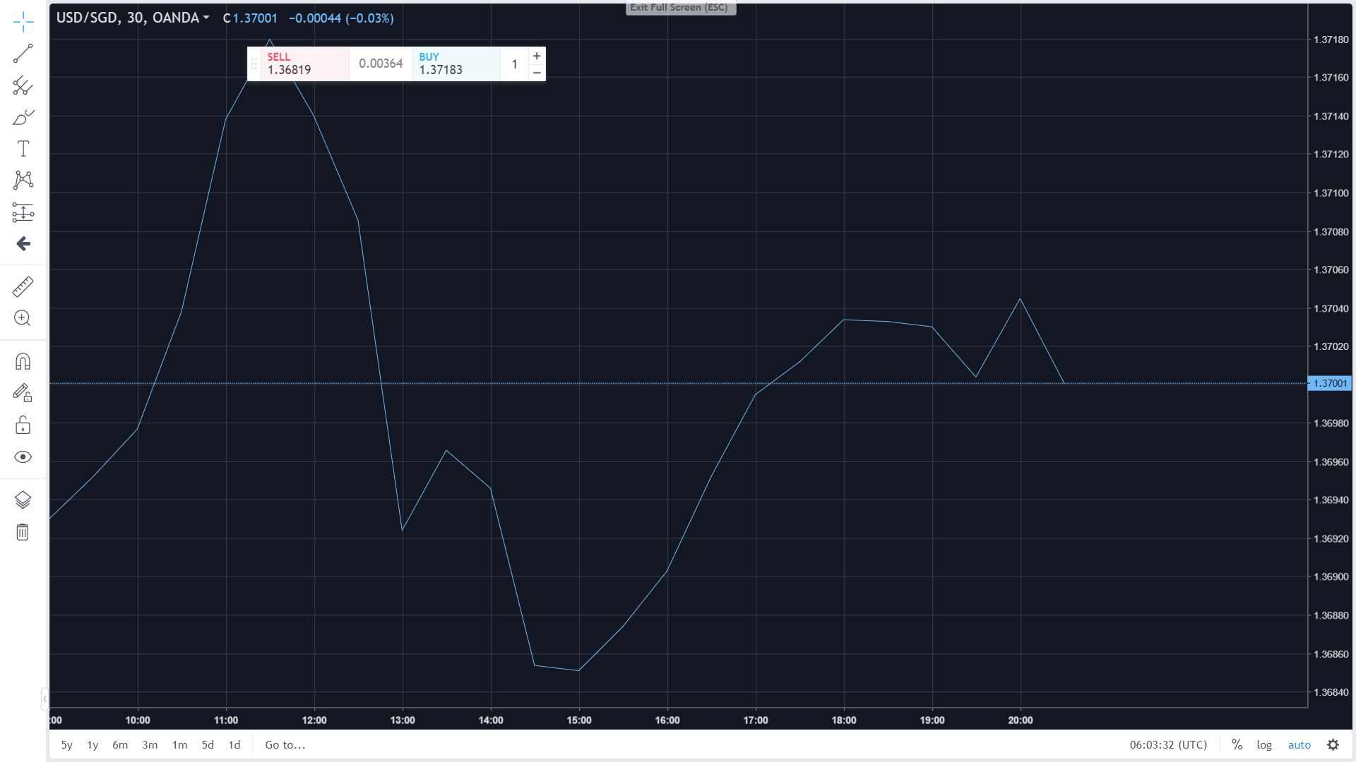
BID CANDLES IN LINE CHART

Slide 23
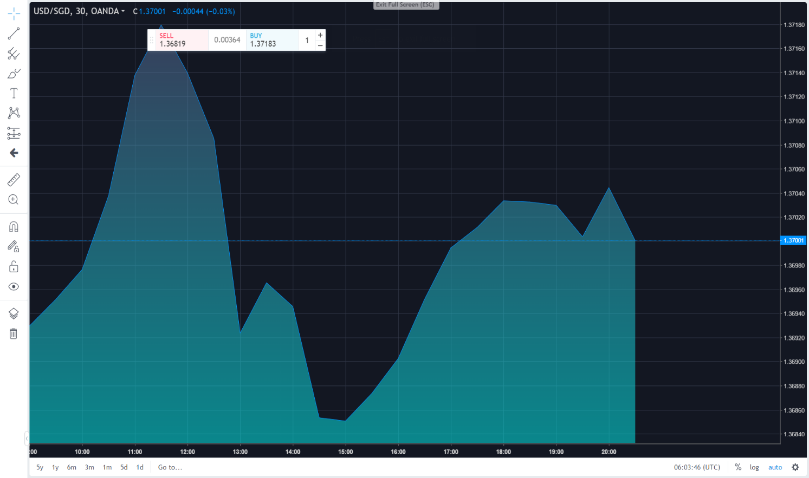
BID CANDLES IN AREA CHART

Slide 24
CONCLUSION
In conclusion, the Python trading bot project successfully demonstrates the development of a sophisticated automated system, covering strategy design, API integration, testing, and performance optimization. It establishes a strong foundation for real-world trading strategies, catering to both novice and experienced traders. The project showcases efficient data handling, from collection to execution, along with comprehensive testing, including backtesting and end-to-end evaluation. The bot's performance is evaluated, and optimizations are applied for enhanced efficiency and reliability. Overall, this project serves as a valuable tool for automating trading strategies and lays the groundwork for future improvements in the dynamic realm of algorithmic trading.

Slide 25

THANK YOU

